Slide 1
CSS Clubs!

Slide 2
Clubs at Charlotte Secondary School
Clubs are:
Mandatory for all students
Only for those not currently failing a class
At the end of the day from 2:00 to 3:00
Every other Friday
Starting this Friday, November 17th!

Slide 3
Available Clubs 2023

Slide 4
Chess Club
Advisors: Lyon & Hudson
This club will allow students to explore the centuries old game of chess. In it we will dive into the fundamental principles and theories of chess. Allowing students to explore the pros and cons to different styles of play. Periodically students will participate in a club tournament to determine who is the current CSS Chess Champion. Come join us and discover the game of Kings and Queens!

Slide 5
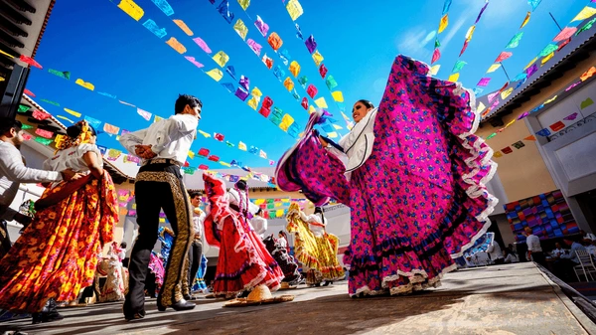
Spanish Club
Advisor: Evanich
We are learning about all the different Latino countries in North, Central, South America and Caribbean.
We learn about their history, traditions, foods, music and definitely dance!

Slide 6
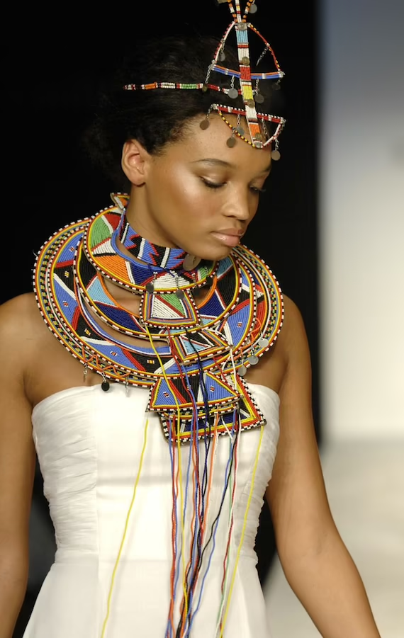
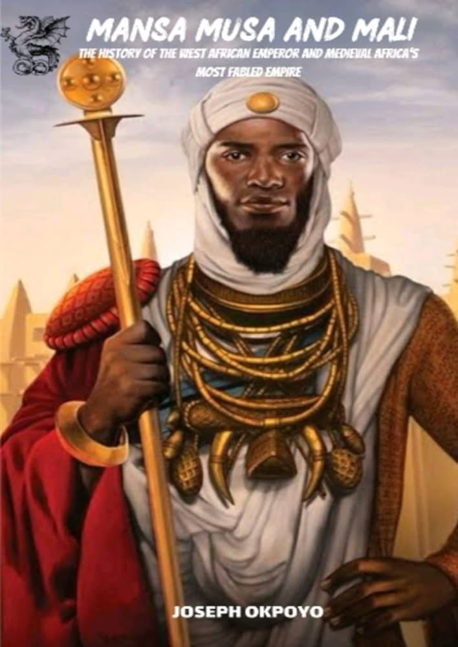
African American Club
Advisor: M. Thomas
The purpose of the AA club is to help students of all races embrace cultural awareness, celebrate the richness of Africa and its people, and expand their knowledge of African American history/culture and the vast contributions African Americans have made to the world.
Activities included but not limited to: African food, music, dance, fashion, and history!

Slide 7
Debate Club
Advisor: Ubaldo
Students will research, analyze, and present information found regarding internationally contemporary issues. These issues are relevant to today's world, and students will have the opportunity to express their thoughts through a safe and protected medium.

Slide 8
Art Club
Advisor: Wright & Wilson
Interested in all things art?
Join our art club, where we will explore many forms of art, such as digital media, theatre, production/performance, visual arts and creative writing, and beautification projects.

Slide 9
McCraw’s McReaders Book Club
Advisor: Rogers
The purpose of McCraw’s McReaders Book Club is to expose students to a wider variety of cultures and stories through the lens of books.
The idea: learn the culture through the book and the book through the culture. In addition, students are encouraged to bring snacks, blankets, and pillows to the club meetings when appropriate.

Slide 10
Girls Club
Advisor: McKernan & Rozier
Girls Club aims to inspire young girls to have a voice, be decision makers, develop problem-solving skills, and create visionary change in their schools and communities.
A girls-only club provides young students a safe space to decompress from challenging situations, discuss issues they are facing without judgment, and become leaders in their community.

Slide 11
Horticulture Club
Advisor: G. Thomas & Tennyson
In horticulture students will dive into the wonderful world of plants and cultivation. Students will learn through a hands-on approach how to grow and tend a variety of plants.
They will learn about all the different factors that affect and go into the growth and development of plants, as they watch them sprout from a seed and become the majestic living thing they were destined to be.

Slide 12
Sports Club
Advisor: Thornton & Bost
A youth sports mentoring program is a program that pairs young athletes with older or more experienced peers who can provide guidance, support, and feedback. The program can help young athletes develop their skills, confidence, and character, as well as foster positive relationships and teamwork. A youth sports mentoring program requires a coach or a professional who can train the mentors and oversee the activities

Slide 13
Thank you

